Slide 1
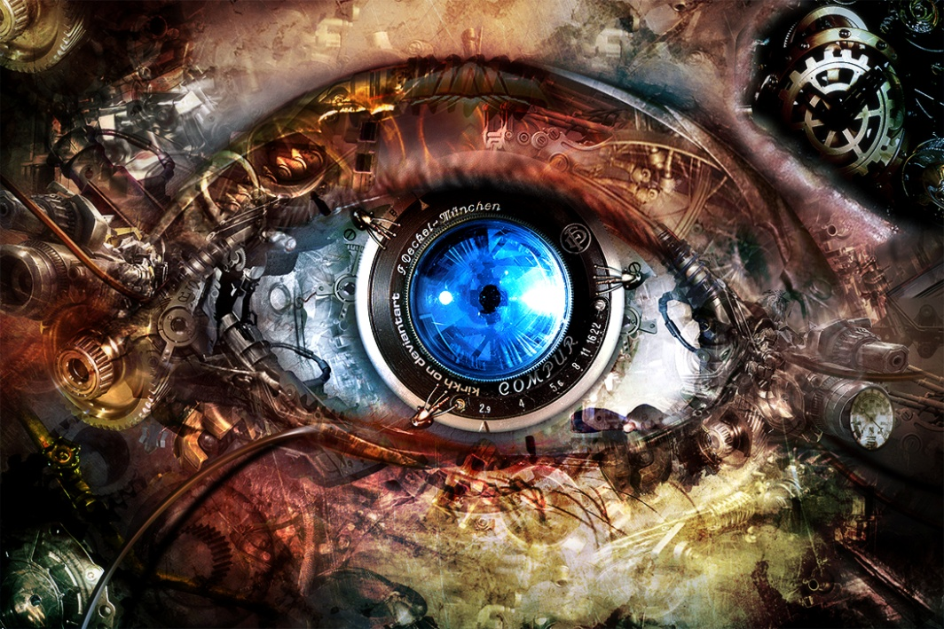
Computer Vision
Petia Ivanova Radeva
petia.ivanova@ub.edu
2023-2024
You can find these slides in Campus Virtual

Slide 2
Theory
Petia Ivanova Radeva - Wednesday, 15:00-17:00h, B7
petia.ivanova@ub.edu
Laboratory
grup F, Wednesday, 17:00-19:00, IF
grup A, Wednesday, 17:00-19:00, ID
grup B, Thursday, 17:00-19:00, ID
Slides, laboratories, deliveries, forum and announcements

Slide 3
Today:
What is Artificial Vision?
A little bit of history
Main problems of Artificial Vision
Difficulties of the Artificial Vision
Applications
Subject organization
Bibliography:
Szeliski, CV: A&A, Ch 1.0 (Introduction)

Slide 4
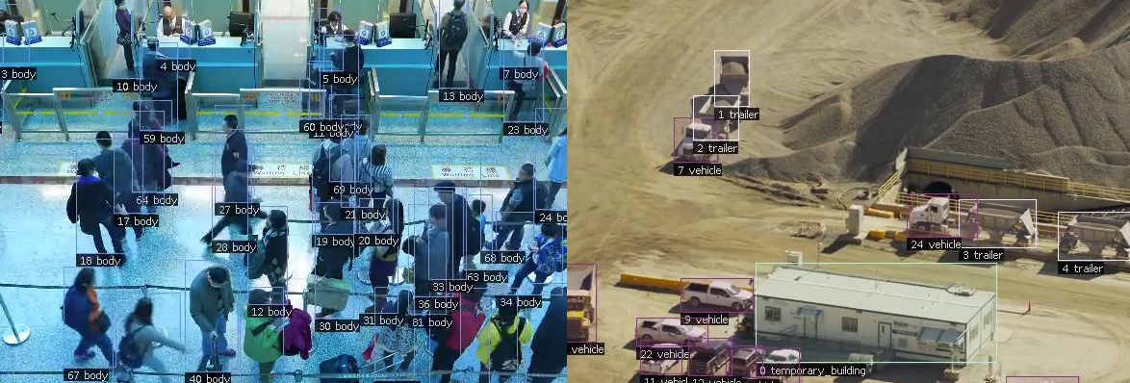
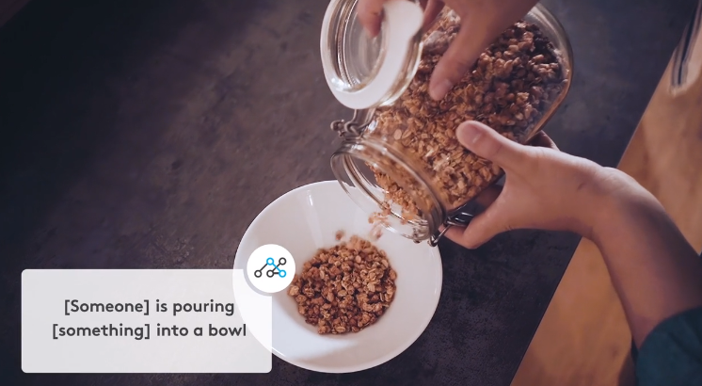
Can you give an example of Computer Vision applications?
Pilot.ai
Location: Palo Alto, CA Employees: 30 Differentiator: End-to-end Powerhouse, both Edge and Cloud
20 billion neurons
Location: Berlin, Germany Employees: 25 Differentiator: Understanding human physical expression
5 Breakthrough Computer Vision Startups to Watch in 2019

Slide 5

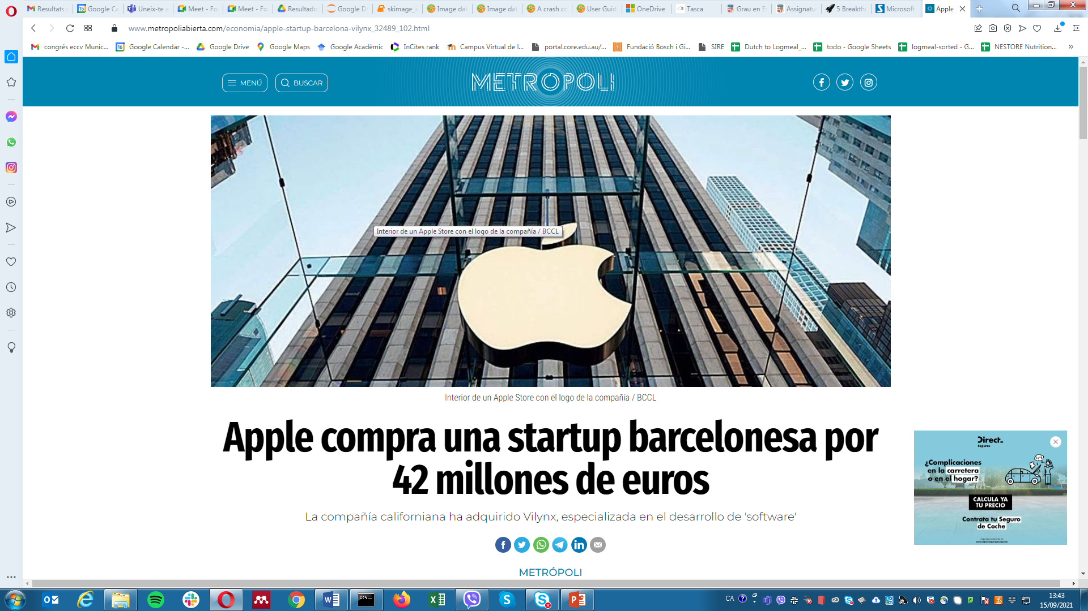
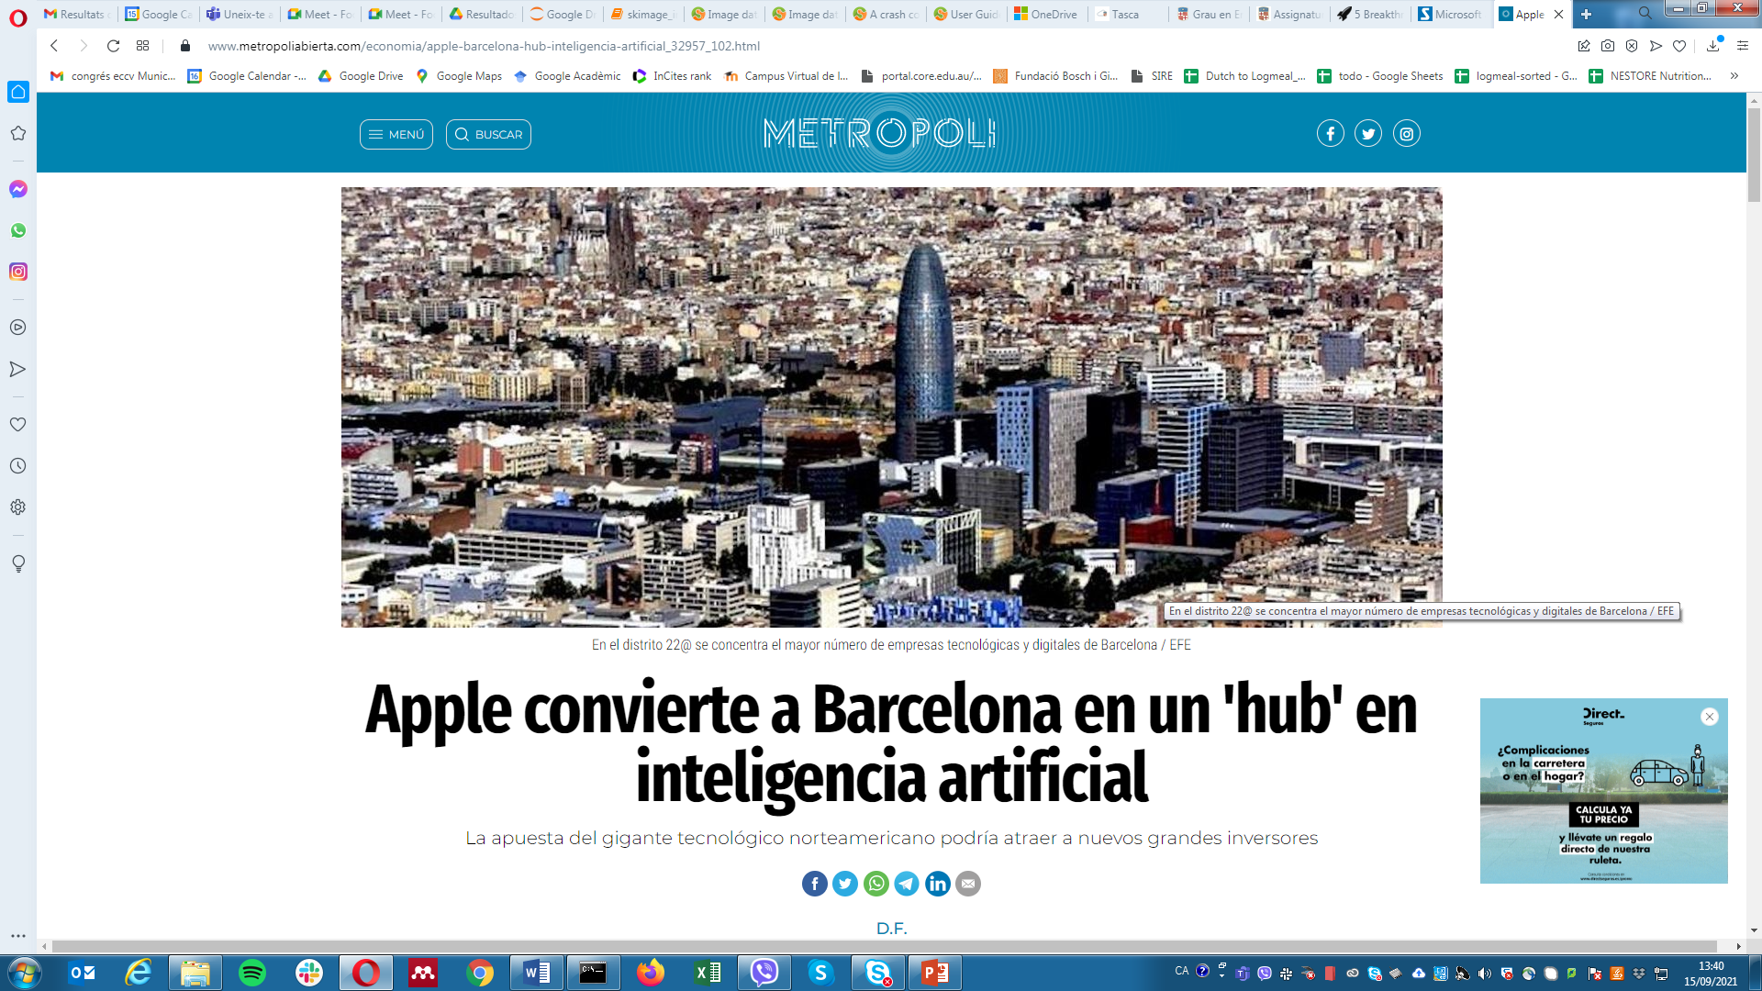
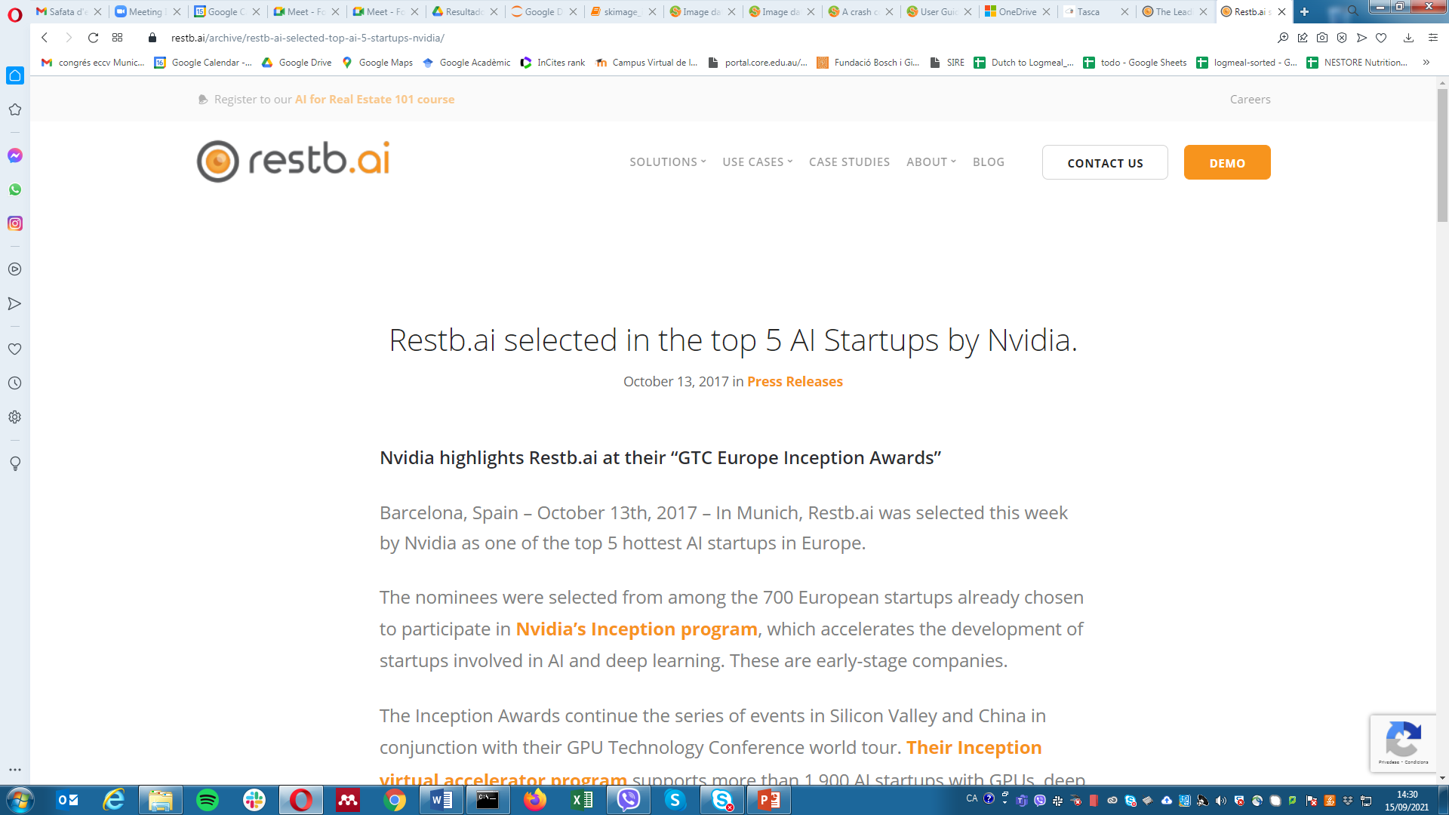


Slide 6






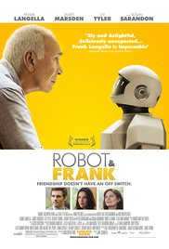
Computer Vision and the Movie Industry
The Terminator (1984, USA)
Minority report
(2002, USA)
Charlie's Angels (2000, USA)
The Incredibles (2004, USA)
Patriot Games (1992, USA)
https://epub.uni-regensburg.de/50867/1/Schmidt_EADH2021_MovieAnalysis.pdf
https://epub.uni-regensburg.de/50867/1/Schmidt_EADH2021_MovieAnalysis.pdf
OCR object recognition, tracking and improving vision.
Gesture recognition
Iris and fingerprint recognition
Person of interest (2007-2013, USA)
Robot and Franc(2012, USA)
Ex Maxhina
Blade Runner 2049
A.I. Artificial Intelligence
Bicentennial Man
Morgan
Automata
Transcendence
Her
Moneyball
The Imitation Game
Satellite images of very high resolution are used for
recovering people and vehicles.
Face recognition
Notes:
Clips: terminator 2, enemy of the state (from UCSD “Fact or Fiction” DVD
Blade Runner 2049
Ethics in AI: The movie reflects all the philosophical questions such as what labels should be assigned to replicants and what happens when artificial characters end up procreating
Strong AI: Artificial general intelligence (AGI), also known as Strong AI, is the ability of a machine to take human-like reasonable decision making
Natural Language Generation: The movie shows exceptionally advanced capabilities to understand voice commands
A.I. Artificial Intelligence
Emotional Intelligence: Along with making machines just ‘intelligent’, we are on our path to empower them with human-like emotions. Not much different than you and I. Perhaps it will be incredible to see this technology surface soon!
Inclusive AI World: You can love a robot and robots can love you. With all the advanced Computer Vision, Natural Language Processing (NLP) and other Machine Learning techniques, this might soon be possible.
1. Blade Runner 2049
One of the most impactful and in-depth storylines in terms of the power of machine learning. The first Blade Runner, released in 1982, was a box-office bomb. It was a movie ahead of its time.
This sequel, Blade Runner 2049, is a movie ripe for today’s machine learning age. This is a detective sci-fi thriller where a detective hunts down and assassinates human-like androids built by the Tyrell Corporation for use in dangerous off-world colonization.
It beautifully shows the rising impact of technology on human society, existence and the very nature of humanity itself. The film’s power is chiefly derived through its stunning imagery of a dark futuristic cityscape and its philosophical themes.
A couple of things that caught my attention as a data scientist:
Ethics in AI: The movie reflects all the philosophical questions such as what labels should be assigned to replicants and what happens when artificial characters end up procreating
Strong AI: Artificial general intelligence (AGI), also known as Strong AI, is the ability of a machine to take human-like reasonable decision making
Natural Language Generation: The movie shows exceptionally advanced capabilities to understand voice commands
2. A.I. Artificial Intelligence
There’s a good chance you’ve seen this movie before. But if you haven’t – you should do so immediately!
It’s possible to feed algorithms and get a machine to work but is it possible for us to instill emotions into them? This field of thought has driven many debates and arguments globally (it’s still an oft-debated topic in tech circles).
The A.I. movie, directed by the great Steven Spielberg, presents the story of a robot boy who desires to nurture human emotions.
A few futuristic techniques that caught my eye while watching this movie:
Emotional Intelligence: Along with making machines just ‘intelligent’, we are on our path to empower them with human-like emotions. Not much different than you and I. Perhaps it will be incredible to see this technology surface soon!
Inclusive AI World: You can love a robot and robots can love you. With all the advanced Computer Vision, Natural Language Processing (NLP) and other Machine Learning techniques, this might soon be possible.
3. Bicentennial Man
Starring Robin Williams, this movie is a drama about how an artificial intelligence-powered life strives to become a human. The Cyborg is used as a butler for a rich family in the movie and as time progresses, it starts exploring its capabilities beyond just intelligence.
It starts connecting to the youngest member of the family in an emotional manner. In a story that spans two centuries, Andrew learns the intricacies of humanity, life, and love.
Here are a few observations from the film relevant to a data scientist:
Cognitive Era – the movie takes a leap into the ‘cognitive era’ with machines capable of thinking and taking decisions just like humans
Ethics in AI – We must really focus on what is coded into the machines. Their ability to co-relate is much advanced than us. To keep the health check of AI intact, it’s important to code the right ethics and cultural values into the machine
The intelligent machine in the movie has lived several generations – imagine the amount of knowledge it has gathered over time. How will we be able to live on par with this intelligence? A deep question that’s been on my mind since watching this movie.
4. Ex Machina
Taut, fascinating and simply intriguing. You will love this action-packed machine learning-based movie.
Ex Machina makes strong arguments for both sides of the machine learning equation.
This Sci-fi classic features a 24-year old coder who wins a chance to spend a week with a prodigy programmer, Nathan Issac. Nathan conducts an experiment to build the world’s first artificial intelligence system into the body of a beautiful girl robot – and then the suspense begins!
This movie triggered my thoughts on – can an advanced machine learning system develop a mind of its own and rival our humanity with something we still can’t see coming?
5. Morgan
This movie is guaranteed to give you goosebumps. Morgan took my breath-away innumerable times and if you like the action-horror genre, then you will be spell-bound by this movie.
Lee Weathers is a “risk-management specialist” for genetic-engineering company SynSect. She arrives at a site hosting its L-9 project, an artificial being with nanotechnology-infused synthetic DNA named Morgan. Morgan displays incredible capabilities of autonomous decision making and sophisticated emotional responses. It’s smarter than humans and keeps maturing with its responses.
A corporate risk-management consultant must decide whether or not to terminate an artificially created humanoid being.
— Sh. D. Adeh
This certainly brings up the case of autonomous vehicles. Think about it – if a self-driving vehicle crashes into a human – who’s responsible? The programmers or the vehicle? There’s no clear answer yet (despite multiple conferences and policies around this).
6. Automata
Automata talks about how the human race is edging out of the world and the machines are stepping in to take over. Sounds familiar? But wait till you watch the movie.
The movie starts with solar flares that make the earth surface radioactive, killing humans. The remaining humans who managed to survive build robots to help them rebuild what they lost.
Jacq works for a robot manufacturing company. As he works along with robots, he discovers that they start stealing and displaying unethical behavior. These robots also start influencing Jacq with philosophical talks and ultimately he gives them the nuclear-powered battery they need to build intersection robots. The climax? That’s incredibly powerful.
7. Transcendence
Oh, I love this movie. It touches on a lot of aspects, including AGI and the debate about ethics.
An artificial intelligence system, played by Johnny Depp, starts building an army of cyborg zombies (which are all modeled after himself). Creating a sentient machine does not go down well with his team. When extremists try to kill the doctor, they inadvertently become the catalyst for him to succeed. His wife and brother can only watch as Depp’s thirst for knowledge evolves to an omnipresent quest for power, and his loved ones soon realize that it may be impossible to stop him.
That’s certainly a strike against AGI, isn’t it?
8. Her
This movie showcases a tool closer to the next level of evolution. ‘Her’ refers to an incredible, intelligent and advanced operating system that is designed to keep your life on track.
This movie is a soft and heartwarming story about a programmer. As a data scientist, it is inspiring to witness such evolutions that are glorifying human life. Can a programmer fall in love with software? Well, you gotta figure this out!
Joaquin Pheonix provides another masterful performance in this movie that I’m sure will stand the test of time. A must-watch!
9. Moneyball
Moneyball is THE most influential story of the modern sports industry. It has spawned data-driven revolutions across sports, such as basketball, baseball (on which it is based), American football, and now even football and cricket.
Based on a true story, Moneyball tells the tale of Billy Bean. He is building Oakland A’s baseball team for the upcoming season. With less money in hand than his rivals, he resorts to relying on data to drive his decision-making process. What happens next is worth watching.
This is a mandatory watch for any sports fan, especially anyone interested in sports analytics. You’ll be trawling through the web looking for advanced sports analytics metrics before the movie finishes!
10. The Imitation Game
Another machine learning movie based on a true story.
The newly created British Intelligence agency MI6 recruits Cambridge mathematics alumnus Alan Turing to crack Nazi codes, including Enigma that cryptanalysts had thought unbreakable.
I highly recommend this movie to anyone involved in the machine learning profession. The Imitation Game aptly depicts the incredible power of mathematics, computer science, and logical thinking.
Alan Turing is a legend in the machine learning world (if you haven’t heard about him or his work, this is a good place to start).

Slide 7
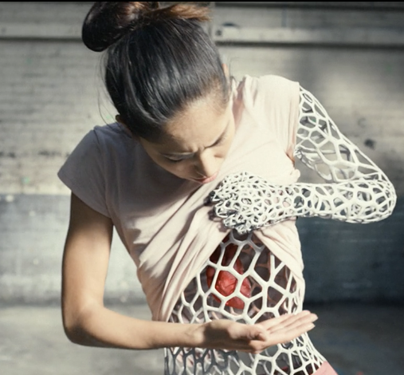
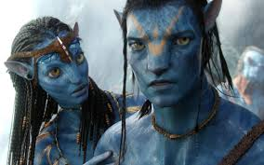
Computer Vision and Visual Effects
THE CHEMICAL BROTHERS
Wide Open
50.571.420 visualizaciones 25 ene 2016 Best of ChemicalBrothers: https://goo.gl/JxwZyH
“Avatar”’2009

Slide 8
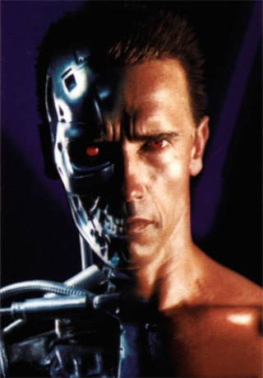
What is Artificial vision?
Computer vision is part of Artificial Intelligence.
It concerns with modeling and replicating human vision using computer software and hardware.
Formally, computer vision is a discipline that studies:
how to perceive i.e. analyze, reconstruct and understand
a 3D/4D scene from its 2D images or videos
in terms of the properties of the structures and phenomena present in the scene.
Terminator 2
Notes:
Clips: terminator 2, enemy of the state (from UCSD “Fact or Fiction” DVD)

Slide 9
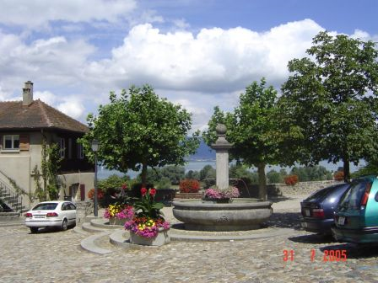
Computer Vision
Make computers understand images and video.
What kind of scene?
Where are the cars?
How far is the building?
…

Slide 10
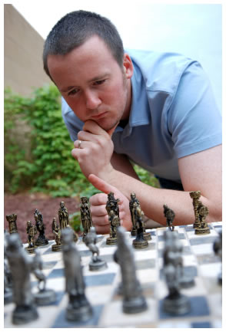
Vision is really hard
Vision is an amazing feature of natural intelligence
More human brain devoted to vision than anything else
Is that a queen or a bishop?

Slide 11
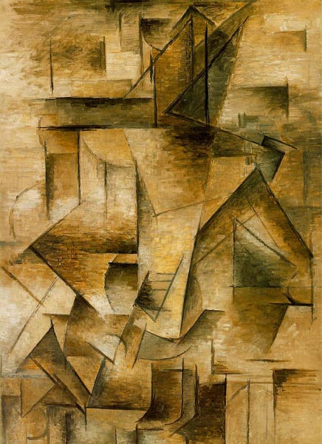
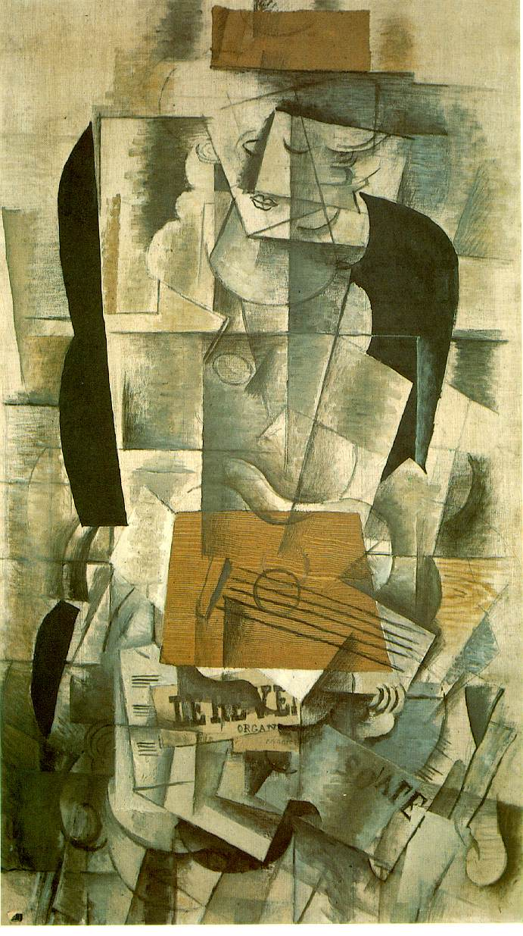
Measurement vs. Perception

Slide 12
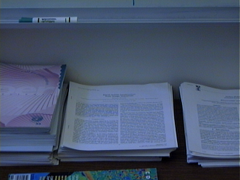

Vision: a split personality
What does it mean, to see? The plain man's answer (and Aristotle's, too), would be, to know what is where by looking.
“Vision is the process of discovering from images what is present in the world, and where it is.” Marr
Answer #1: pixel of brightness 243 at position (124,54)
…and depth .7 meters
Answer #2: looks like bottom edge of whiteboard showing at the top of the image
Which do we want?
Is the difference just a matter of scale?
depth map

Slide 13
What is Computer Vision?
Vision is about discovering from images what is present in the scene and where it is.
In Computer Vision a camera (or several cameras) is linked to a computer.
The computer interprets images of a real scene to obtain information useful for tasks such as navigation, manipulation and recognition.

Slide 14
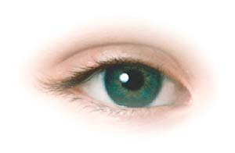


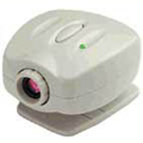
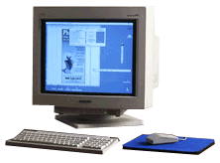
The problem
Want to make a computer understand images
We know it is possible – we do it effortlessly!
Real world scene
Sensing device
Interpreting device
Interpretation
Nature
A butterfly on rocks
Strange color painted stones
An artistic image
Notes:
Sounds easy: we do it effortlessly
Eyes “take the picture” then brain interprets it for us
Want computer to be able interpret digital images

Slide 15
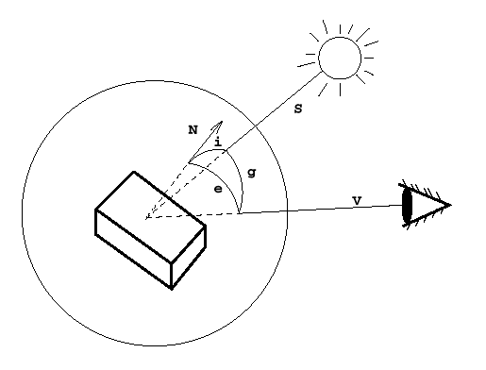
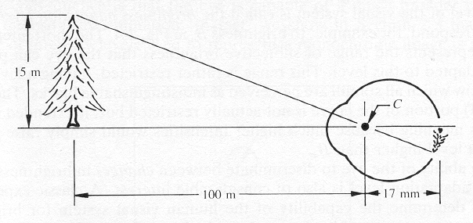
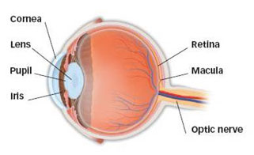
The Human Eye
Retina measures about 5 × 5 cm and contains 10⁸ sampling elements (rods and cones).
The eye’s spatial resolution is about 0.01◦ over a 150◦ field of view.
Intensity resolution is about 11 bits/element, spectral range is 400–700nm.
Temporal resolution is about 100 ms (10 Hz).
Two eyes give a data rate of about 3 GB!

Slide 16
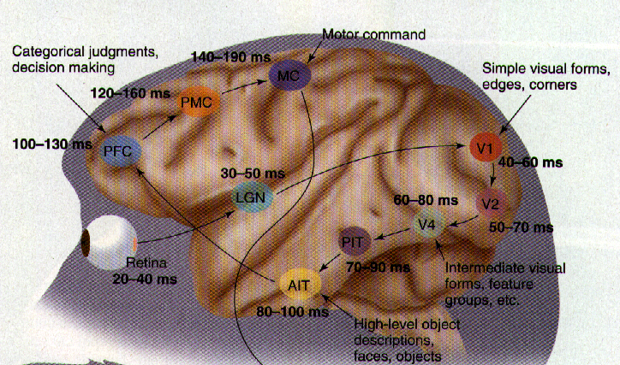
Human visual system
Vision is the most powerful of our own senses.
[Thorpe et. al.]
Around 1/3 of our brain is devoted to processing the signals from our eyes.
The visual cortex has around O(10¹¹) neurons.

Slide 17
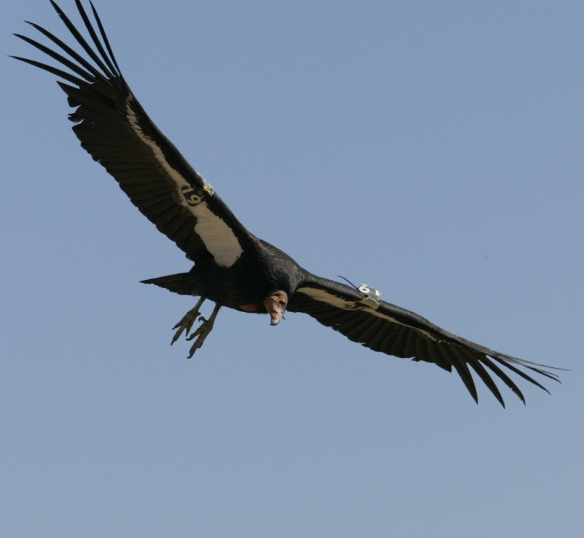

Why don’t we just copy the human visual system?
People try to, but we don’t yet have a sufficient understanding of how our visual system works.
O(10¹¹) neurons used in vision
By contrast, CPUs have O(10⁶) transistors (most are cache memory).
GPUs – a great news! They have billions (10⁹) of transistors.
Very different architectures:
Brain is slow, but parallel.
Computer is fast, but mainly serial.
Bird vs Airplane
Same underlying principles.
Very different hardware.
Notes:
Researchers do try and simulate what we know about our visual system
- e.g. simple and complex cell responses in V1

Slide 18
Why to study it?
Gain insight into how we see
Vision is explored extensively by neuroscientists to gain an understanding of how the brain operates
Replicate human vision to allow a machine to see:
Central to that problem of Artificial Intelligence
Many industrial and real life human-centric applications

Slide 19
Today:
What is Artificial Vision?
A little bit of history
Main problems of Artificial Vision
Difficulties of the Artificial Vision
Applications
Subject organization
Bibliography:
Szeliski, CV: A&A, Ch 1.0 (Introduction)

Slide 20
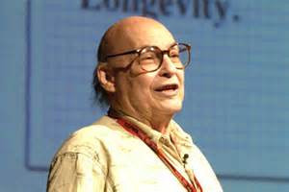
The Vision Story Begins…
In 1966, Marvin Minsky at MIT asked his undergraduate student Gerald Jay Sussman to “spend the summer linking a camera to a computer and getting the computer to describe what it saw”.
We now know that the problem is slightly more difficult than that. (Szeliski 2009, Computer Vision)

Slide 21

Vision...
Mar’s Historical definition
Q: How to answer:
What is this?
R: By a sequence of data transformations.
Surface interference by stereo vision, motion, etc.
Images
2D structures
3D features
3D Solids 3D
Objects
Dice
Image analysis: lines, contours, etc.
Syntactic nature

Slide 22
Historical definitions...
The mechanism that allows visual perception is the OPTICAL INVERSE ENGINEERING!
“Processing visual information is syntactic in nature (and consists of a set of modules that reconstruct general descriptions of the scene).”
“The semantics should be treated in a purely symbolic way as a result of the syntactic analysis.”
David Marr, Vision, Freeman, 1982.

Slide 23
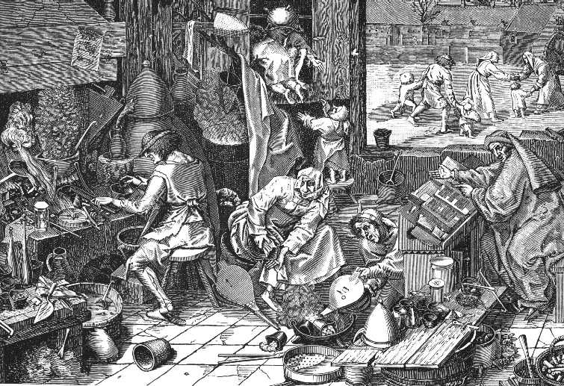
Vision...
But the environment is complex...
...not accessible, continuous, dynamic and non determinist. And this is a BASIC component of the problem...

Slide 24
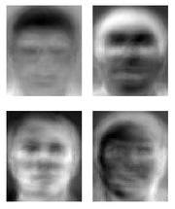
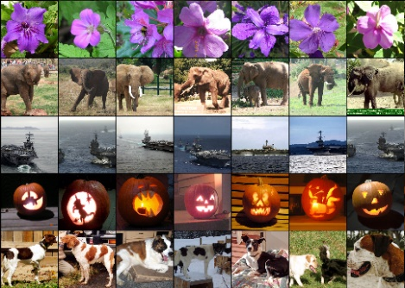
Ridiculously brief history of computer vision
1960’s: interpretation of synthetic worlds
1966: Minsky assigns computer vision as an undergrad summer project
1970’s: some progress on interpreting selected images
1980’s: ANNs come and go; shift toward geometry and increased mathematical rigor
1990’s: face recognition; statistical analysis in vogue
2000’s: broader recognition; large annotated datasets available; video processing starts
2000’s: Deep learning is back to stay, CNN
2010’s: Deep learning beats humans on object recognition
2030’s: robot uprising?
Guzman ‘68
Ohta Kanade ‘78
Turk and Pentland ‘91
Imagenet: 15 mlln of images

Slide 25
Today:
What is Artificial Vision?
A little bit of history
Main problems of Artificial Vision
Difficulties of the Artificial Vision
Applications
Subject organization
Bibliography:
Szeliski, CV: A&A, Ch 1.0 (Introduction)

Slide 26
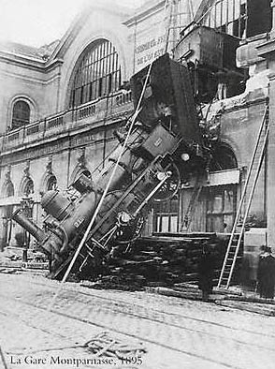
Each image tells a story…
The aim of the Artificial vision is to write programs to interpret images, and perceive the story behind the image
Get the properties of the real world as 3D, names of persons or objects, etc.?!
Can computers beat the men?
Yes and no (mostly not!)
Humans are better at "hard" things
Computers are better at "easy" things
Limit is getting thinner and thinner.

Slide 27
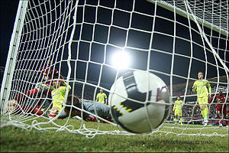
Computer Vision: A whole series of problems
What is in the image?
- Object recognition problem
Where is it?
- 3D spatial layout
Shape
How is the camera moving?
What is the action?

Slide 28
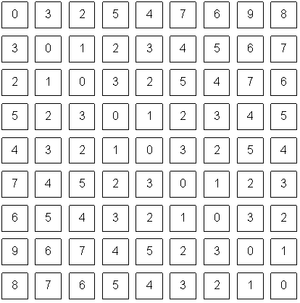
Computer Vision bridges the gap between pixels and “meaning”
What we see
What a computer sees
Source: S. Narasimhan

Slide 29
CV problems Formation of the image: Image is a projection of the world
A point of the scene corresponds to one and only one point in the image,
but a point of the image may correspond to infinite points of the scene (3D world).

Slide 30
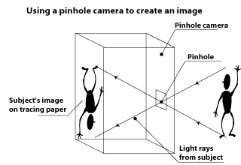
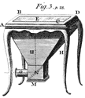
Image is a projection of the world
Pinhole camera

Slide 31
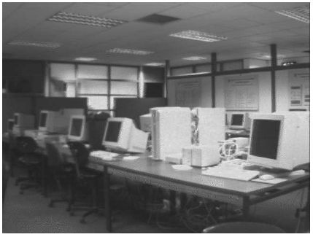
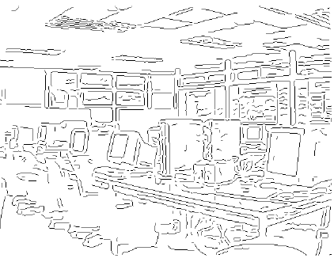
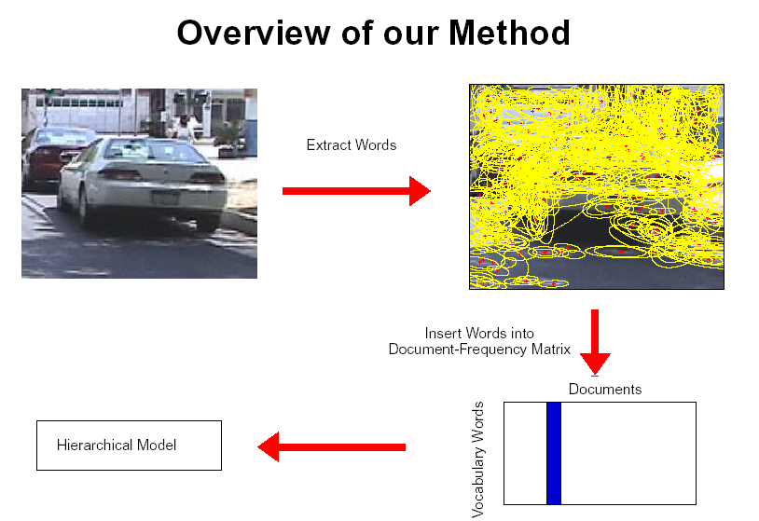
CV problems: Low-Level Feature extraction
Edges, corners
Local regions

Slide 32
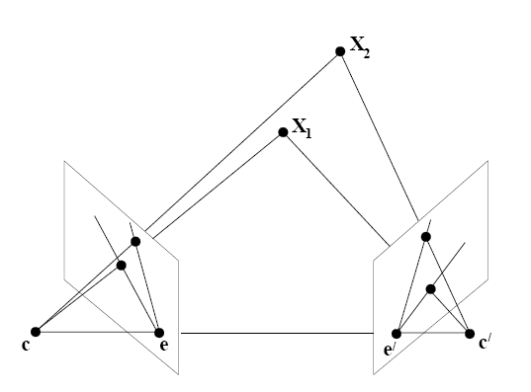
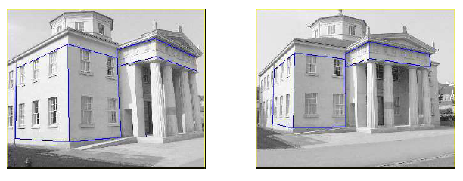
CV problems: Stereo Vision
By having two cameras, we can triangulate features in the left and right images to obtain the depth to the 3D point.
Need to match features between both images:
Correspondence Problem

Slide 33
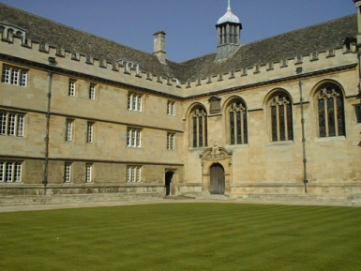
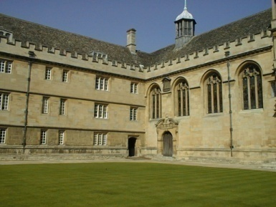
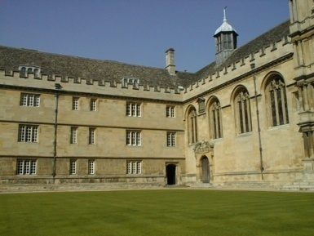
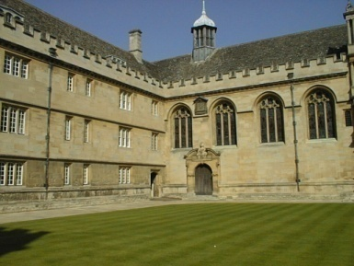
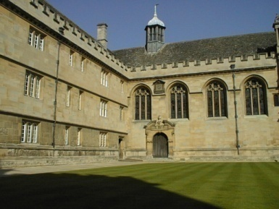
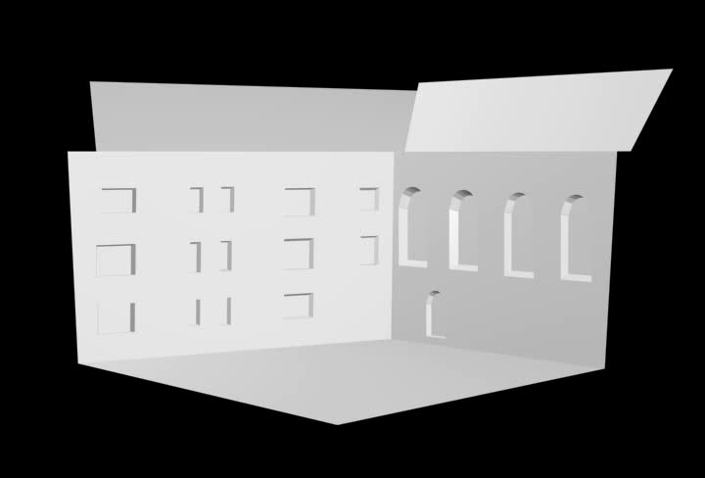
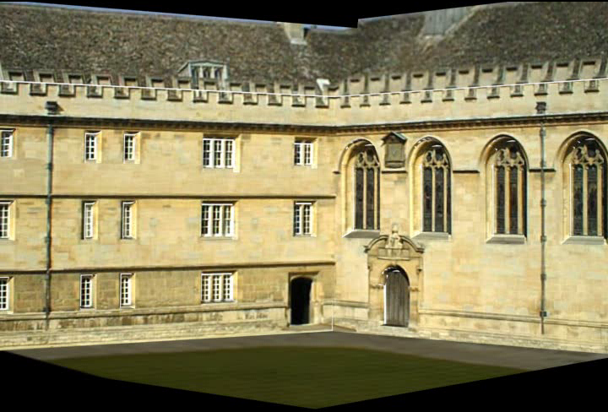
CV problems: Geometry:
3D models of planar objects
[Fitzgibbon et. al]
[Zisserman et. al. ]

Slide 34
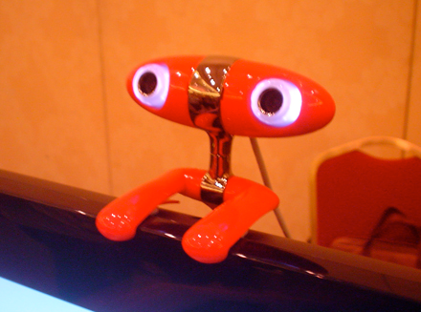
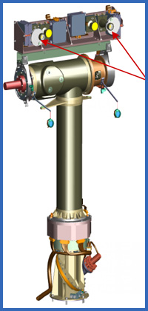
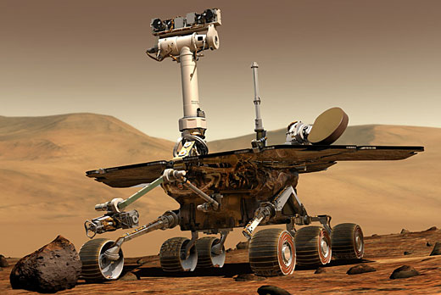
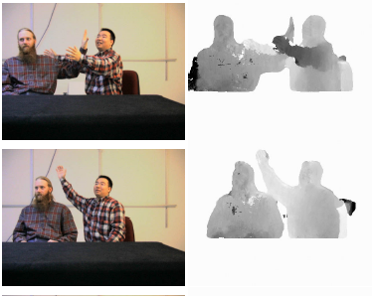
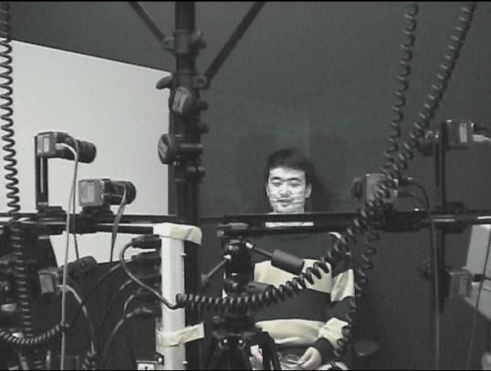
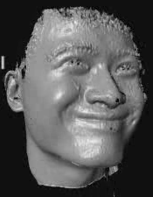
CV problems: 3D reconstruction by depth cameras
Get the 3D shape of the objects

Slide 35


CV problems: Shape from Shading
Recover scene structure from shading in the image

Slide 36


CV problems: Shape from Texture
Texture provides a very strong cue for inferring surface orientation in a single image.
Necessary to assume homogeneous or isotropic texture.
Then, it is possible to infer the orientation of surfaces by analyzing how the texture statistics vary over the image.

Slide 37

CV problems: Augmented reality

Slide 38




CV problems: Segmentation
Image
Segmentation

Slide 39


CV problems: Scene interpretation from limited cues

Slide 40

CV problems: Human motion detection

Slide 41



Johansson’s experiments [‘70s]

Slide 42

CV problems: Object detection

Slide 43

Object categorization
mountain
tree
building
banner
street lamp
vendor
people

Slide 44

Object and person recognition

Slide 45

What do humans care about?
slide by Fei Fei, Fergus & Torralba

Slide 46
Verification: is that a bus?
slide by Fei Fei, Fergus & Torralba

Slide 47
Detection: are there cars?
slide by Fei Fei, Fergus & Torralba

Slide 48
Identification: is that a picture of Mao?
slide by Fei Fei, Fergus & Torralba

Slide 49
Object categorization
sky
building
flag
face
banner
wall
street lamp
bus
bus
cars
slide by Fei Fei, Fergus & Torralba

Slide 50
Scene and context categorization
outdoor
city
traffic
…
slide by Fei Fei, Fergus & Torralba

Slide 51
Rough 3D layout, depth ordering
slide by Fei Fei, Fergus & Torralba

Slide 52
Today:
What is Artificial Vision?
A little bit of history
Main problems of Artificial Vision
Difficulties of the Artificial Vision
Applications
Subject organization
Bibliography:
Szeliski, CV: A&A, Ch 1.0 (Introduction)

Slide 53







Why is it hard?
Variation of point of view
Scale
IIlumination

Slide 54






Why is it hard?
Movement (Font: S. Lazebnik)
Intra-class variation
Cluttered background
Occlusion

Slide 55


Why is it hard?
Local ambiguity
slide credit: Fei-Fei, Fergus & Torralba

Slide 56

Some things know that you have eyes
Brady, M. J., & Kersten, D. (2003). Bootstrapped learning of novel objects. J Vis, 3(6), 413-422

Slide 57

Bottom-up data analysis
The problem is the ambiguity of the implicit perception
Many 3D scenes can give the same 2D scene
We need information about the World in order to unambiguate the images.
Image source: F. Durand

Slide 58

Is the human perception perfect?
Sinha and Poggio, Nature, 1996
We still don’t understand completely the perception in order to simulate / model / copy it
Notes:
Example where humans make mistakes that computers can avoid

Slide 59

Why is it difficult? Visual illusions
In the visual percepcion different factors intervene associated with aspects of the observer and his/her environment.
The knowledge acquired culturally.
Assumptions about the world acquired for evolution.
Visual memory and past experiences.
The architecture of the human visual system.

Slide 60

Copyright A.Kitaoka 2003

Slide 61

Visual illusions
http://www-bcs.mit.edu/gallery

Slide 62

Visual illusions

Slide 63
Today
What is Artificial Vision?
A little bit of history
Main problems of Artificial Vision
Difficulties of the Artificial Vision
Applications
Subject organization
Bibliography:
Szeliski, CV: A&A, Ch 1.0 (Introduction)

Slide 64

Is Artificial vision useful?

Slide 65

Computer vision today
Only a few examples:
Most have less than 15 years!
A very active and changing area
Expected numerous applications the next 5-10 years!
Computer Vision companies

Slide 66



















Why to study Computer Vision?
Each second million of images are captured and stored
Numerous real applications
Source: S. Lazebnik

Slide 67

Deep learning

Slide 68




Deep learning

Slide 69






Assisted driving
Pedestrian and car detection
meters
Ped
Ped
Car
meters
Lane detection
Collision warning systems with adaptive cruise control,
Lane departure warning systems,
Rear object detection systems,
Slide credit Fei-Fei, Fergus, Torralba CVPR07 Short Course

Slide 70

Medical images and health

Slide 71









Surveillance and security: biometric systems
Fingerprint identification, facial recognition, iris and retinal scan, hand geometry, geometry of the ear, signature recognition, voice identification, identification of the DNS, the smell of human characteristics or recognition of typing motion (not a privilege of science fiction anymore).

Slide 72








Surveillance and security: biometric systems
US-VISIT
Border control
3M
Viisage
You are not just being recorded….you are being watched.
Poseidon-Tech
> “Alert!!!
> A Person is forcing
a Ticket Machine!!”

Slide 73










Media and Entertainment
Gaming interfaces
Augmented Reality
ARmusement
Sony EyeToy (for PlayStation) allows players to interact with games using motion, color detection and sound.
Digital Photography
Photosynth (Microsoft LiveLabs)
GestureFX. Gesture Interfaces ground, wall or table.

Slide 74








Media and Entertainment
Augmented TV
PVI: Virtual publicity in real television pictures.
Hawk Eye: tracking the ball in game sports.

Slide 75








Mobile Computer Vision
Client services
For visually impaired
Health services
Android Developer Challenge (Google): Barcode Reader for price list and product information
Tourism

Slide 76





Cultural inheritance
Arqueology
Old documents
Manuscript recognition
3D reconstruction of ceramics
Restauration
Engravings analysis

Slide 77







Improving online search
Query:
street
Organizing photo collections
Slide credit Fei-Fei, Fergus, Torralba CVPR07 Short Course

Slide 78




Amazon farm

Slide 79
Today:
What is Artificial Vision?
A little bit of history
Main problems of Artificial Vision
Difficulties of the Artificial Vision
Applications
Subject organization

Slide 80

In this subject we will:

Slide 81
Subject content
Presentation and introduction
The subject. What is Computer Vision?
Features detection
Edge detection. Differential operators. Discrete approximations. Discontinuities.
Detection and localization of contours. Differential operators. Structure of the image.
Visual characteristics (HOG, Harris, SIFT), etc.
Shape
Contours and Segmentation
Texture analysis and image retrieval.
Recognition
Object detection.
Recognition based on appearance. Face recognition.
Convolutional Neural Networks

Slide 82

Laboratory environment
Python & Anaconda
Numpy
Scikit-image
Matplotlib

Slide 83
Laboratories
Will be based on the material seen in theory and problems classes.
Some deliveries may include small abstracts, techniques, etc.
English:
Theory slides
Additional material:
Videos and videolectures
Articles and other literature

Slide 84
Laboratory deliveries
Continuous Evaluation
NEC=0.5*NEF+0.1*MP+0.4*NS
Pr1
Pr2
Pr3
Exams
Pr4
Mini-
project
…
Average
grade
NEF
PrN
Average
grade
NS
Final
grade
Notes:
84

Slide 85
Avaluació continuada
La nota Final de l’assignatura, Nota_Final, es calcularà segons la següent fórmula:
Nota_Avaluació_Continuadal = 0.5 * Nota_Examens + 0.1*Nota_Adicional + 0.4 * Nota_Sessions_Pràctiques
on:
Nota_Examens és la nota de les proves parcials.
Nota_Sessions_Pràctiques és la nota promitja de diferents lliuraments de pràctiques. Aquests lliuraments són presencials.
Nota_Adicional és la nota que contempla diferents activitats que es poden incloure per a valorar l’assignatura (nota del miniprojecte).
Nota_Examens = 0.6 * Nota_Examens_Teoria + 0.4 * Nota_Examens_Pràctiques
on:
Nota_Examens_Teoria és la nota de l’examen de teoria dels parcials.
Nota_Examens_Pràctiques és la nota de l’examen pràctic dels parcials.
Per a poder fer el càlcul de la Nota_Final, és condició imprescindible que:
- l’estudiant obtingui: Nota_Examens_Teoria >= 4.0 i Nota_Examens_Pràctiques >= 4.0
s’aprovin per separat els dos parcials!
Qualsevol intent de frau realitzat durant el curs comportarà l’aplicació de la normativa acadèmica general de la UB i l’inici d’un procés disciplinari.

Slide 86
Single Evaluation
Final exam:
Theory exam ET +
Practical exam EP
Final grade
FG=0.6*ET+0.4*EP
Approved if ET>=4, EP>=4 and Final grade >=5.
Notes:
86

Slide 87
Avaluació ùnica (Finals d’Octubre – Termini)
L’estudiant que es vulgui acollir a l’avaluació única haurà de sol·licitar-ho a la secretaria de la Facultat dins dels terminis establerts a cada curs acadèmic.
Per avaluació única, ha de passar una prova final on s’avaluaran conceptes teòrics i pràctics de l’assignatura de la següent manera
Nota_Final = 0.6* Nota_Teoria + 0.4 * Nota_Pràctiques
On:
Nota_Teoria: nota de l’examen final on s’inclouen aspectes a avaluar propis de l’avaluació única de la part de teoria,
Nota_Pràctiques: nota de la part pràctica (preguntes i problemes sobre els continguts de les pràctiques de l’avaluació continuada, problemes específics pràctics de coneixements, etc.).
Per a poder fer el càlcul de la Nota_Final, és condició imprescindible que l’estudiant obtingui:
Nota_Teoria >= 4.0 i Nota_Pràctiques >= 4.0

Slide 88
Reavaluació:
Un alumne té dret d’anar a l’examen de reavaluació si NF>=3.5. L’examen de reavaluació tindrà part teòrica (RT) i part pràctica (RP) i la nota final de l’assignatura serà:
NF=0.6*RT+0.4*RP.
Observacions:
a) Les pràctiques no són recuperables. Una pràctica no presentada té una nota 0.
b) Un “No presentat” en l’avaluació continuada és quan no s’ha presentat cap pràctica ni s’ha fet cap parcial.
c) Les notes no es guarden d’un any per a un altre.
d) Si es suspèn alguna de les parts d’activitats (teoria o pràctiques) en l’avaluació continuada durant el semestre, s’ha de fer l’examen sencer; no es guarda la part aprovada.
i) Algunes de les pràctiques poden ser pràctiques avaluables, on el treball pràctic es defineix i es lliura al final de la sessió.
f) Els estudiants que fan la reavaluació renuncien la nota anterior obtinguda.

Slide 89



Bibliography
Programming Computer Vision with Python: Tools and algorithms for analyzing images 1st Edition, Jan Erik Solem, O’Reilly, 2012.
Computer Vision: Algorithms and Applications (c) 2010 Richard Szeliski, Microsoft Research http://szeliski.org/Book/
David A. Forsyth, Jean Ponce, Computer Vision: A Modern Approach, Prentice Hall, Hardcover, August 2012, II edition.

Slide 90
Mini-projects
Groups of 4 students should be formed to work on a mini-project. The title and the group should be submitted before 15/11/2022.
Memory of 5 pages should explain:
target
environment / context
information about the implementation,
alternatives and extensions to the application as seen in the course material.
Introduction to Virtual Campus.
These mini-projects will have a weight of 10% of the final grade of continuous evaluation.
The projects will be presented in the last two lectures.

Slide 91















Miniprojects

Slide 92
Additional material
Get inspired for the miniprojects!

Slide 93

Computer Vision APIs

Slide 94

Computer Vision in Healthcare

Slide 95


Human pose estimation

Slide 96

How Computer Vision Can Help Fight Climate Change

Slide 97

The biggest Computer Vision applications
Everything happening in Computer Vision that you should kno4 Steps to Start Machine Learning with Computer Vision
Artificial Intelligence is expected to be a $60 billion industry by 2025. Join the industry by learning specialized skills in the most transformative AI field; Computer Vision.
Top 10 Computer Vision Frameworks You Need To Know In 2022
Augmented Intelligence: AR, VR, MR
27+ Most Popular Computer Vision Applications and Use Cases in 2022
Computer Vision Applications: A Detailed Look
TOP 100 MACHINE LEARNING PROJECT IDEAS FOR TECH ENTHUSIASTS
Computer Vision: Applications in Manufacturing, Surgery, Traffic, Satellites, and Unlabelled Data Recognition
Computer Vision for Recognition of American Sign Language
Real-Time Computer Vision Applications
The 87 Most Popular Computer Vision Applications for 2023
Everything happening in Computer Vision that you should know
ETHICAL ISSUES IN TOPICAL COMPUTER VISION APPLICATION
Top 7 Computer Vision Applications in Marketing
What is Computer Vision? The Ultimate Guide
(Computer) Vision without Sight
Top Emerging Computer Vision Trends 2022

Slide 98

Hype cycle for Artificial Intelligence, 2021

Slide 99

SALARY OF CV EXPERTS

Slide 100


Number of AI papers in Scopus

Slide 101


Some more references of interest
https://www.youtube.com/watch?v=Tzv9T8wTykU
https://www.youtube.com/watch?v=PT7Q9u9m5es
https://www.youtube.com/watch?v=ty5QtslaAHM
https://www.youtube.com/watch?v=XZAwtbkELRA
https://www.youtube.com/user/CVOwebsite
https://www.youtube.com/watch?v=_uwZrzLFizE
https://www.youtube.com/watch?v=H4arwvdC7Z4
https://www.youtube.com/watch?v=NHThkxUP-S8
https://www.youtube.com/watch?v=1Ugo2KEV2XQ
https://www.youtube.com/watch?v=5rQBH1TH9pA

Slide 102

Robots in hospitals

Slide 103

Internet of Things

Slide 104

Visiting Mars

Slide 105


Interactive Games
Object Recognition
Mario
3D
Robot, etc.

Slide 106

3D viewers
Earth viewers (modelatge 3D), Imatge des de Microsoft’s Virtual Earth
(veure també: Google Earth)

Slide 107

Photosynth
http://photosynth.net/
Photo Tourism technology

Slide 108



Optical character recognition (OCR)
Technology to convert scanned docs to text
If you have a scanner probably came with OCR software
Plates recognition
http://en.wikipedia.org/wiki/Automatic_number_plate_recognition
Digits recognition, AT&T labs

Slide 109


Face detection
Almost all digital cameras: Canon, Sony, Fuji, …
Notes:
Why would this be useful? Main reason is focus. Also enables “smart” cropping.

Slide 110

Face analysis
NEC Corporation

Slide 111

Google maps

Slide 112

Picasa

Slide 113
Smile detection
Sony Cyber-shot® T70 Digital Still Camera

Slide 114

Object recognition in supermarkets
LaneHawk by EvolutionRobotics
“A smart camera is flush-mounted in the checkout lane, continuously watching for items. When an item is detected and recognized, the cashier verifies the quantity of items that were found under the basket, and continues to close the transaction. The item can remain under the basket, and with LaneHawk,you are assured to get paid for it… “

Slide 115




Vision based biometrics
“As an Afghan girl was identified by his employer iris“,… Read the story
Discover the story about the Afghanistan's girl and iris recognition

Slide 116


Mobile visual search: Google Goggles

Slide 117


Mobile visual search: iPhone Apps

Slide 118




Login without password…
Fingerprints for many portable scanners or other devices
Face recognition

Slide 119

Mobile recognition
Microsoft Research
Point & Find, Nokia

Slide 120


Visual effects: shape capture
Matrix, ESC Entertainment, XYZRGB, NRC

Slide 121


Visual effects: shape capture
Pirates of the Carribean, Industrial Light and Magic

Slide 122

Sport
Sportvision first down line

Slide 123

Intelligent cars
Mobileye
Vision systems in BMW, GM, Volvo, Folkswagen
In 2010: 70% of the manufactured cars.
- video

Slide 124

Google cars
Oct 9, 2010. "Google Cars Drive Themselves, in Traffic". The New York Times. John Markoff
June 24, 2011. "Nevada state law paves the way for driverless cars". Financial Post. Christine Dobby
Aug 9, 2011, "Human error blamed after Google's driverless car sparks five-vehicle crash". The Star (Toronto)

Slide 125



Vision based interaction
Digimask: put the face of a person to the avatar.
Nintendo Wii. Work of Lee’s
from CMU how to use:
multi-touch display!
“Game turns moviegoers into Human Joysticks”, CNET
A camera following the audience:aquest treball.

Slide 126

Vision in the space
NASA'S Mars Exploration Rover Spirit captured this westward view from atop a low plateau where Spirit spent the closing months of 2007.
Vision systems (JPL) for:
Panorama stitching
3D Terrain Modeling
Obstacle detection, tracking the position
“Computer Vision on Mars” by Matthies et al.

Slide 127


Industrial robots
Vision-guided robots position nut runners on wheels

Slide 128


Robotics
NASA’s Mars Spirit Rover
http://en.wikipedia.org/wiki/Spirit_rover
http://www.robocup.org/

Slide 129


Elder people assistance

Slide 130


Medical diagnosis and intervention
3D Images
MRI, CT
Grimson et al., MIT

Slide 131

Photo Tourism

Slide 132

Snaptell

